Slide 1

NETFLIX DATA ANALYSIS
Kashifa Shah
Internship ID: STU6828a35915ed01747493721

Slide 2

PROBLEM STATEMENT
“Netflix needs to understand how its content library—Movies vs. TV Shows, genres, and country contributions—has evolved over the years to make data-driven strategic decisions for content acquisition and production.”
Key Points:
Netflix’s library is vast and diverse, spanning multiple countries and genres.
Competitors like Amazon Prime, Disney+, and regional OTT platforms are growing.
Netflix must identify content trends, audience preferences, and underrepresented categories.
The goal is to provide actionable insights to optimize content strategy, improve audience engagement, and strengthen global market presence.

Slide 3
Project Description
The project will involve analyzing a Netflix dataset (7,789 records, 11 columns) to uncover content trends and patterns. The analysis will cover:
Distribution Analysis: How Movies vs. TV Shows have evolved over the years.
Genre Analysis: Identify most popular genres and track their popularity over time.
Country-wise Contributions: Examine content contributions from different countries.
Strategic Insights: Provide recommendations based on trends for content production, acquisition, and global expansion.
The project combines data cleaning, exploratory data analysis (EDA), visualization, and insights generation to produce actionable recommendations.

Slide 4

WHO ARE THE END USERS?
Netflix Decision Makers: Content strategists, production planners,and market analysts.
OTT Industry Analysts: Researchers who track streaming content trends and market dynamics.
Academics/Students: Those studying media analytics, data-driven decision-making, or business intelligence.

Slide 5

Technology Used
Programming Language: Python
Libraries:
pandas for data manipulation
numpy for numerical operations
matplotlib & seaborn for data visualization
plotly or dash for interactive dashboards (optional)
IDE/Environment: Jupyter Notebook or VS Code
Data Storage: CSV or Excel file
Optional: Tableau/Power BI for enhanced dashboards

Slide 6
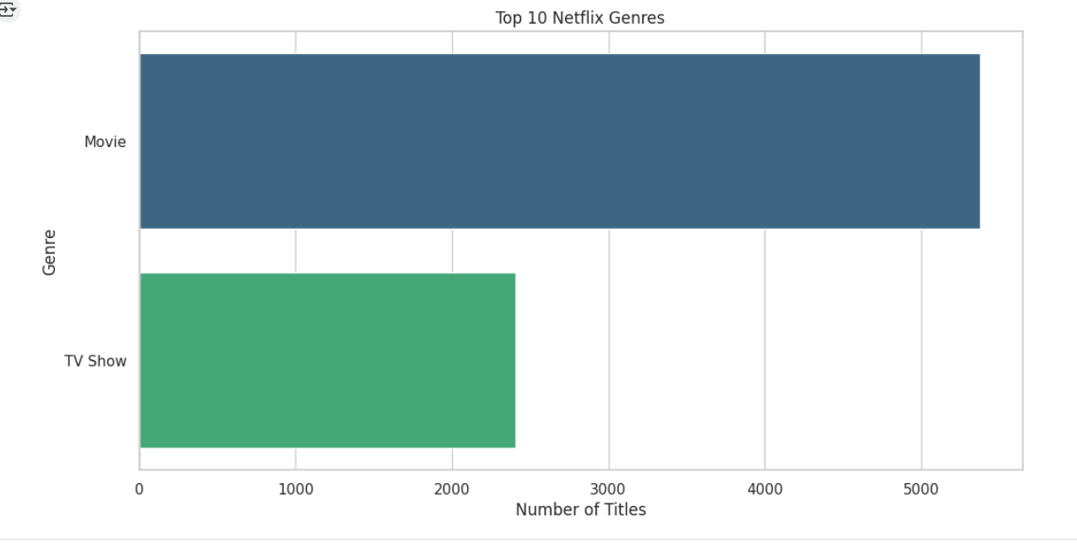
RESULTS1
Demo Link

Slide 7
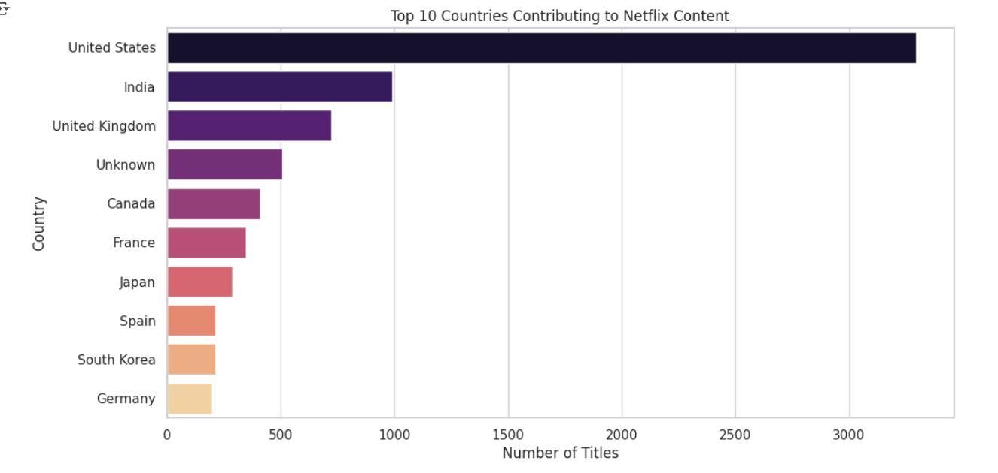
RESULTS2
Demo Link

Slide 8
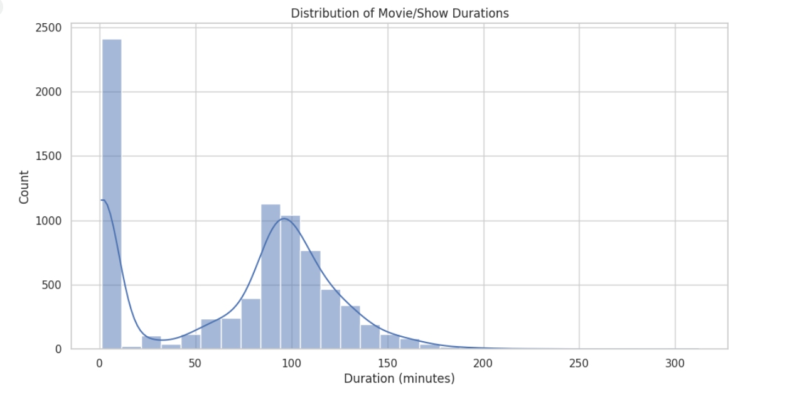
RESULTS3
Demo Link

Slide 9
GitHub repository
https://github.com/kashifashah1/VOIS_AICTE_Oct2025_MajorProject_KashifaShah.git
Demo Link

Slide 10

Getting started with Basics of Python Certificate

Slide 11

Data Visualization Certificate

Slide 12
Thank you
.
.

